Slide 1
Who is GICF?
Background, Ministries & Opportunities
Oct 19th 2014

Slide 2
History – A look back
Late 80s – US consulate staff apartment at White Swan Hotel
Pre 1992-1994ish – at Garden Hotel (in American School)
1994-1998– at the Greenery, Tian He (in American School). (Around 80-120 people by 1998).
1998 - 2012 Star Hotel (Shanghai IF was shut down by PSB as an illegal organization. In those days, there was no licensing of foreign fellowships. Once the SIF had been closed, we knew the authorities would close us down, too. We prayed then went to the Provincial RAB and introduced ourselves. Discussion began with the authorities in Beijing which led to a new policy allowing foreign fellowships to register legally, with Guangzhou being chosen as the test-case. We were invited to share in the drafting of the regulations, and after 2 years of preparation, the new law came into effect in August 2000. We were presented with License No.001. The following year, the procedure was opened up to the other International Fellowships in China.
2003 SARS - attendance dropped
October 2008 (attendance about 600) GICF North/Pingsha fellowship begins (in 2009 this became Grace Union church & The Fountains)
July 2012 – Moved to the Westin, Guangzhou
July 2013 – Moved to the Hilton (approx 500 including children)
2??? – Moving to be with Jesus forever

Slide 3
Structure & Characteristics
Presiding Elder Darius Thomson
Glenn Gyimah
Eddie Lawrimore
Head Deacon Alfred Leong
Richard Wong
Graham Noble
Jason Dexter
Martin Asare
Elders & Deacons = leadership team
Since 2010

Slide 4
2014 Survey Data

Slide 6
Statement of Faith
God There is one God, the Father, Son, & Holy Spirit. All things are made for his glory.
The Lord Jesus Christ is fully God & fully man, and he lived a sinless life. On the cross he died in the place of sinners, bearing God’s punishment for their sin. He rose from the dead & ascended into heaven where he is exalted as Lord of all.
God There is one God, the Father, Son, & Holy Spirit. All things are made for his glory.
The Bible God has revealed himself in the Bible. Every word was inspired by God through human authors, so that the Bible is in its entirety the Word of God, without error and fully reliable. The Bible alone speaks with final authority and is always sufficient for all matters of belief and practice.
The Human Race All men and women, being created in the image of God, have inherent and equal dignity and worth. Their greatest purpose is to obey, worship and love God. As a result of the fall of our first parents, every aspect of human nature has been corrupted and all men and women are without spiritual life, guilty sinners and hostile to God. Every person is under the just condemnation of God and needs to be born again, forgiven and reconciled to God in order to know and please him.
The Lord Jesus Christ is fully God & fully man, and he lived a sinless life. On the cross he died in the place of sinners, bearing God’s punishment for their sin. He rose from the dead & ascended into heaven where he is exalted as Lord of all.
Salvation is entirely a work of God’s grace and cannot be earned or deserved. It has been accomplished by Jesus and is offered to all. God forgives sinners whom he calls, granting them repentance and faith. All who believe in Christ are adopted into the family of God and receive eternal life.
The Holy Spirit has been sent from heaven to glorify Christ and to apply his work of salvation. He convicts sinners, imparts spiritual life and gives a true understanding of the Scriptures. He indwells all believers, brings assurance of salvation and produces increasing likeness to Christ (sanctification). He builds up the Church and empowers its members for worship, service and mission.
The Bible God has revealed himself in the Bible. Every word was inspired by God through human authors, in its entirety it is the Word of God, without error and fully reliable. The Bible alone speaks with final authority and is always sufficient for all matters of belief and practice.
The Holy Spirit has been sent from heaven to glorify Christ & to apply his work of salvation. He convicts sinners, imparts spiritual life and gives a true understanding of the Scriptures. He lives in all believers, gives assurance of salvation & helps us become more like Christ (sanctification). He builds up the Church and empowers its members for worship, service and mission.
The Human Race All men and women, being created in the image of God, have inherent and equal dignity and worth. Their greatest purpose is to obey, worship and love God. As a result of the fall of our first parents, every aspect of human nature has been corrupted and all men and women are without spiritual life, guilty sinners and hostile to God. Every person is under the just condemnation of God and needs to be born again, forgiven and reconciled to God in order to know and please him.
Salvation is entirely a work of God’s grace and cannot be earned or deserved. It has been accomplished by Jesus and is offered to all. God forgives sinners whom he calls, granting them repentance and faith. All who believe in Christ are adopted into the family of God and receive eternal life.

Slide 7
A Word about Denominational Differences
The Holy Spirit
Is given to believers at salvation (they are born again by the Spirit of God. John 3:5)
Produces FRUIT in the believer (Gal 5:22-23) which is more important than…
Gives GIFTS to the church AS HE WISHES (“…the same Spirit works all these things, distributing to each one individually as He wills. 1 Cor 12:11)
Appearing to have the gifts is not evidence of salvation (Matthew 7:21-23 Not every one that says to me, Lord, Lord, shall enter into the kingdom of heaven; but he who does the will of my Father which is in heaven. Many will say to me in that day, Lord, Lord, have we not prophesied in your name? and in your name have cast out devils? and in your name done many wonderful works? And then will I profess unto them, I never knew you: depart from me, you that work iniquity.
Tongues is only 1 gift of 9 listed there. It is not required as evidence of having the Holy Spirit. It is only to be used as directed in I Cor 14 & is not for public ‘vain babbling.’ Tongues does not need to be ‘learned’.
Notes:
Tolerance is the key. Sound doctrine is the goal.

Slide 8
Who is GICF?
YOU!

Slide 9
Greeters, Ushers, & Setup - Jason Dexter
Sunday School & Youth - Sung You
Prayer Ministry - Glenn Gyimah
Small Groups/Preaching - Eddie Lawrimore
Music Ministry - Martin Asare
Sound - Richard Wong / Graham Noble
Admin & logistics - Alfred Leong
Website - Graham Noble
Library - Diane Nall

Slide 10
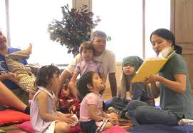
Sunday School & Youth
Are you called to share your teaching gift with children & young people? Don’t be a pew warmer! Share your gift in children’s ministry.
Toddlers (0-2)
Bubbles (3-5)
Primaries (6-8)
Juniors (9-10)
Middlers (11-12)
Youth

Slide 11
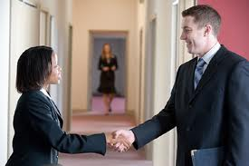
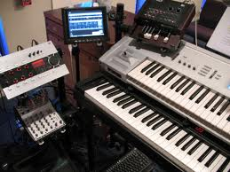
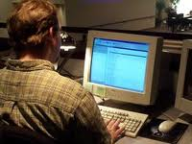
Greeting & Ushering
We are the first people visitors see in God’s house. We try to make people feel comfortable and welcome.
Setup
The “early birds” who help set up & take down equipment in the main hall & Sunday School classes.

Slide 12
Small Groups
Small groups for
Fellowship & Accountability
Bible Study & Prayer
Opportunities for:
small group leaders
people to hosts small groups

Slide 13
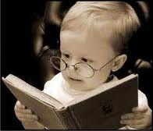
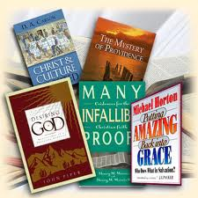
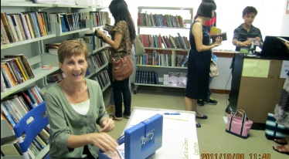
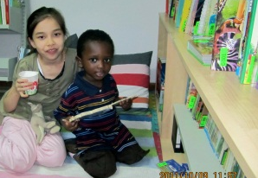
Library
Open: 9:15–9:50 &11:30–12:15
Books, Music, Movies, Documentaries, Sermons, Bibles
See Diane Nall

Slide 14
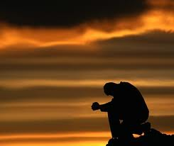
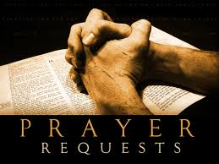
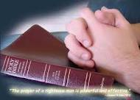
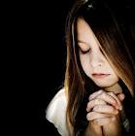
Prayer Ministry
“men ought always to pray and not lose heart.” Luke 18: 1-8
When?
Sunday Prayer 9:00am - 9:55am.
Prayer meetings Monday – Saturday
Where?
Star Hotel (Mon-Sat), The Hilton (Sunday)
Notes:
Intercessor:
"He saw that there was no man, and wondered that there was no intercessor." - Isaiah 59:16
"No one calls on your name or strives to lay hold of you." - Isaiah 64:7
What do we do?
We engage in a battle against the darkness over individuals, churches, cities, states, countries, and nations, and the opening of the eyes of the blind in the spirit.
Meeting dyas/time:
Sunday morning: Time: 9:00am - 9:55am Place: Right across the main entrance.
Sunday after service: Time: 11:40am - 12:00noon, Place: Behind the purple door.
Mid-week Prayer meeting, Thursdays: Time: 7pm - 8pm, Place: Star hotel room 521.
Other voluntary commitment.
Prayer chain, at least 30mins extra demand on our prayer time at least for a week for the Church of God.
“Every failure is a prayer failure.” – Asking and Receiving by John R. Rice
So we have to set time and committed to it.
“We must set aside time for prayer. We will never have time for prayer; we must make time.” – Richard Foster

Slide 15
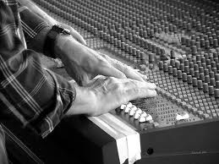
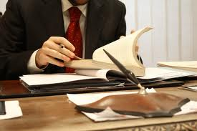
Admin
Duty: Various errands & helping with co-ordination with the hotel.
Wanted – If you are:
Organized,
Have adequate time
A patient personality and,
Have a humble heart to serve others with administrative matters
Able to speak Chinese and English would be a plus.
Please see Alfred Leong.
Notes:
Administration
Wanted: If you are organized, have adequate time, a patient personality
and a humble heart to serve others with administrative matters, which may
include various errands and helping with co-ordination, please volunteer as
an administrator. Being able to speak Chinese and English would be a plus.
Please see Alfred Leong.

Slide 16
Technical
Duties:
Website design, administration
Audio/Video system support, mp3 recording
Software projects
Wanted Skill:
Web site design
Please see Graham Noble/Walton Hu
Notes:
Administration
Wanted: If you are organized, have adequate time, a patient personality
and a humble heart to serve others with administrative matters, which may
include various errands and helping with co-ordination, please volunteer as
an administrator. Being able to speak Chinese and English would be a plus.
Please see Alfred Leong.

Slide 17
Who is GICF?
YOU!
Don’t drift away!
Get involved in the life of the fellowship & be amazed at how God helps you to grow in your time here.

